Slide 1




Mini Project
Mid-Sem Evaluation
Player Detection and Analysis
Group 1
16010120002 - Aryan Balpande
16010120003 - Kavya Bansal
16010120016 - Vinod Ghanchi
16010120017 - Kaushik Iyer

Slide 2
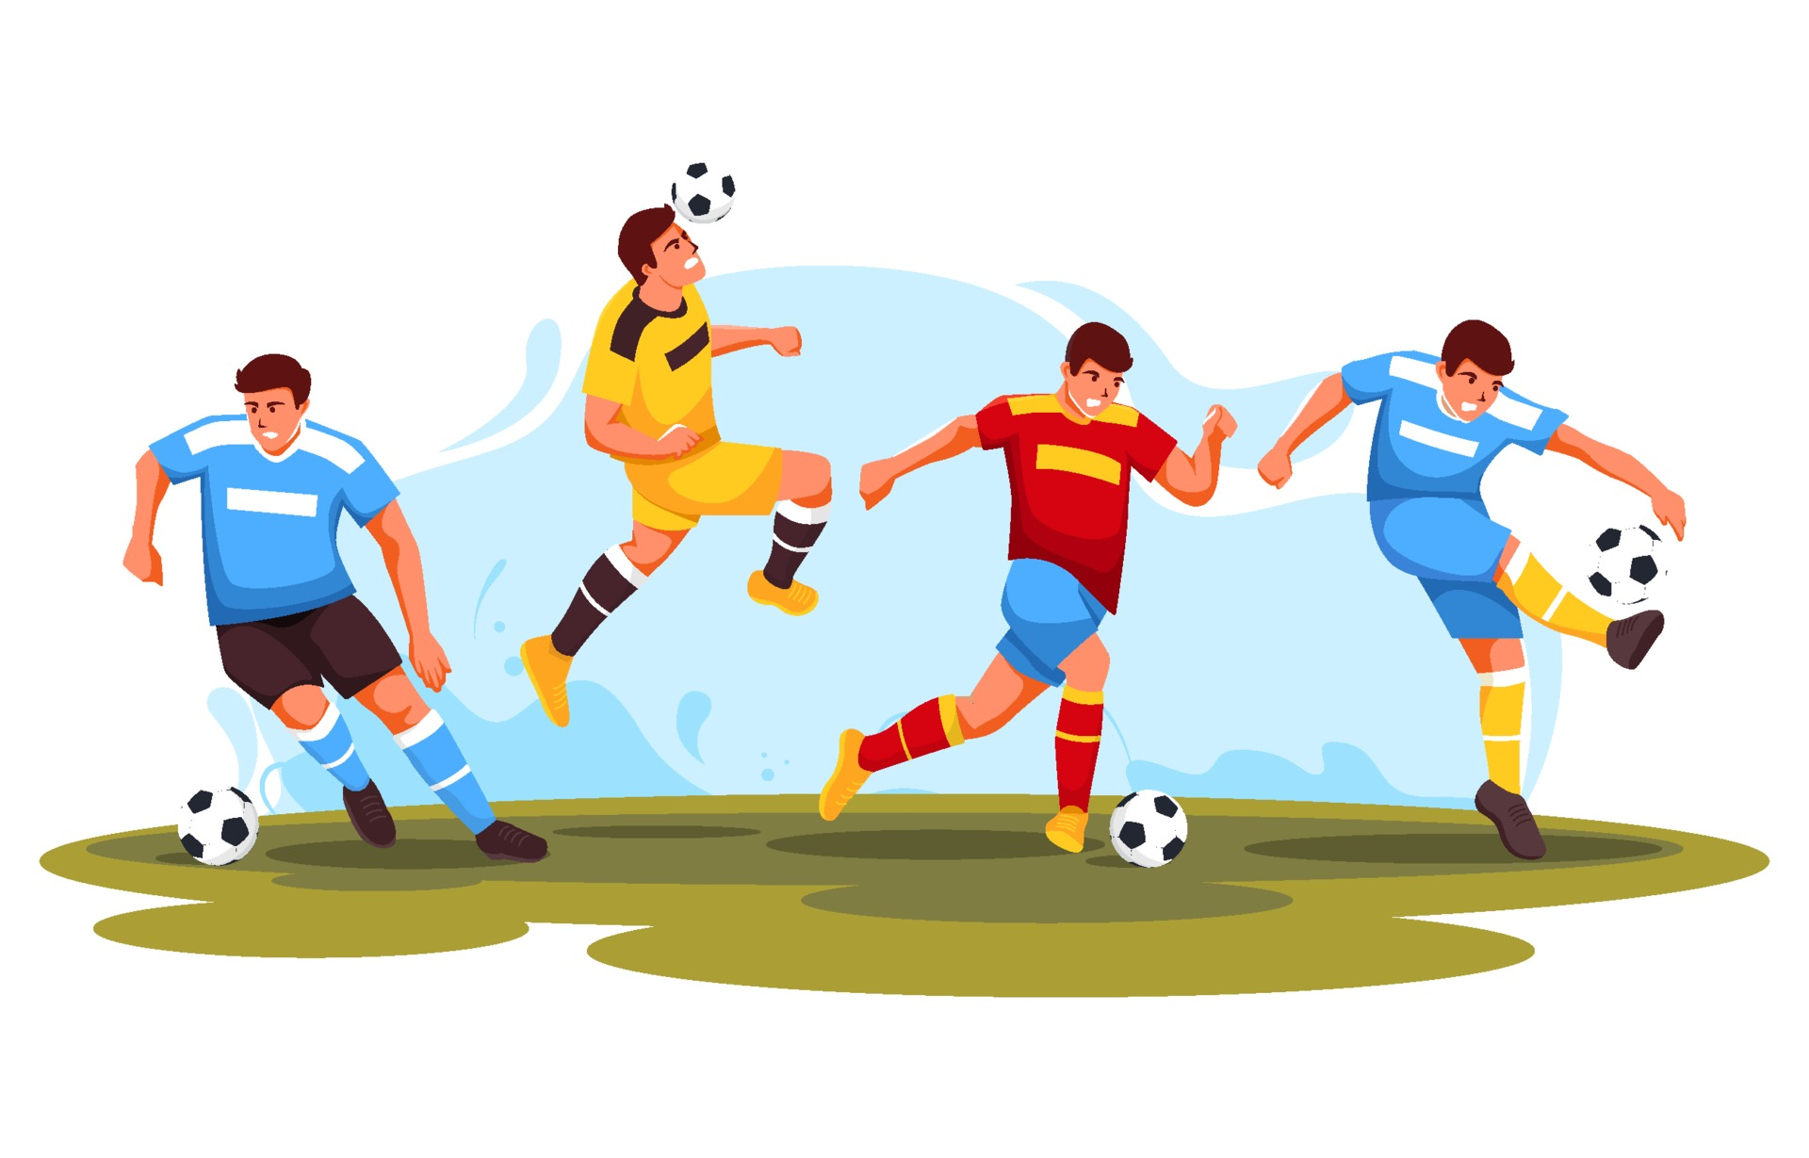
Problem Statement
Develop a player detection and analysis system to help sports teams and coaches improve their performance by analyzing the movements and actions of individual players during games and practice sessions.
The system should be able to track the players' movements and actions using various cameras and then use this data to provide real-time feedback to coaches and players.

Slide 3

Objective
Develop a system that can track and analyze player movements and actions
Use the collected data to provide feedback to coaches and players
Continuously update and refine the system based on feedback

Slide 4
Literature Survey
Author | Thesis Title | Reference | Published
Tianyi Wang | Deep Learning-Based Football Player Detection in Videos | https://www.ncbi.nlm.nih.gov/pmc/articles/PMC9296282/ | Published online 2022 Jul 12. doi: 10.1155/2022/3540642
Matija Buric Miran Pobar Marina Ivasic-Kos | Ball detection using Yolo and Mask R-CNN | https://ieeexplore.ieee.org/stamp/stamp.jsp?arnumber=8947818 | 2018 International Conference on Computational Science and Computational Intelligence (CSCI)

Slide 5
Research Paper 1
The Research paper compares the performance of two of the state-of-the art convolutional neural network-based object detectors for the task of ball detection
The performance of YOLO and Mask R-CNN for sports ball detection greatly improved after being trained on additional examples of sports balls. YOLO achieved a significant increase in F1 score, although at the cost of additional false positives, while Mask R-CNN had higher precision and provided additional segmentation information.
Overall, the study highlights the importance of training models on custom datasets to achieve better performance on specific tasks.

Slide 6
Research Paper 2
The research paper "Deep Learning-Based Football Player Detection in Videos" proposes a new method for detecting football players in video footage using deep learning algorithms.
Their method uses a deep convolutional neural network (CNN) to detect players in individual frames of a video. The authors evaluated their method on a publicly available dataset of football videos, and found that it outperformed several other state-of-the-art methods in terms of accuracy and efficiency.
The proposed method has potential applications in football analytics and coaching, as well as in sports broadcasting and highlight reel creation.

Slide 7
Literature Survey
By observing and going through all of the different research papers explored, we understand that the YOLO algorithm is the go-to method for object and player detection.
All models considered in this paper use low-level knowledge inherited from pre-trained publicly available weights. In such a way the time needed for training is drastically reduced in comparison with training the models from scratch, with the additional benefit of shared knowledge about low-level features trained on the large quantity of input data.
Results show that it can perform well even on random football match videos obtained from TikTok, indicating the wide applications of this algorithm. Moreover, this player detection algorithm is faster than the state-of-the-art R-CNN object detector and can be used for real-time football player detection.

Slide 8
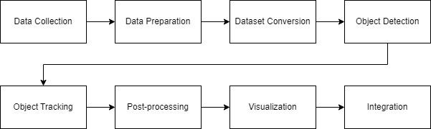
Architecture

Slide 9
Technologies Used
Roboflow: A computer vision platform that provides a suite of tools for training, deploying, and improving object detection models.
Google Colab
YOLOv5: YOLOv5 is a state-of-the-art real-time object detection system developed by Ultralytics. It is the latest iteration of the YOLO (You Only Look Once) series of object detection models that uses deep neural networks to detect objects in images and videos.
ByteTrack: ByteTrack is designed for real-time video object detection and tracking, and it is particularly well-suited for applications such as autonomous driving, surveillance, and robotics. The algorithm works by detecting objects in each video frame using a YOLOv5 network, and then using a combination of optical flow and object matching techniques to track those objects across multiple frames.

Slide 10
Status
Took the Bundesliga clips dataset from Kaggle
Split the clips into frames (1/second) in Roboflow
Annotate players, referees, and football in every frame
Split chosen frames into train, test, and validation sets
Generate model on Roboflow
Train the model on Yolov5
Obtain model weights to use on project code

Slide 11
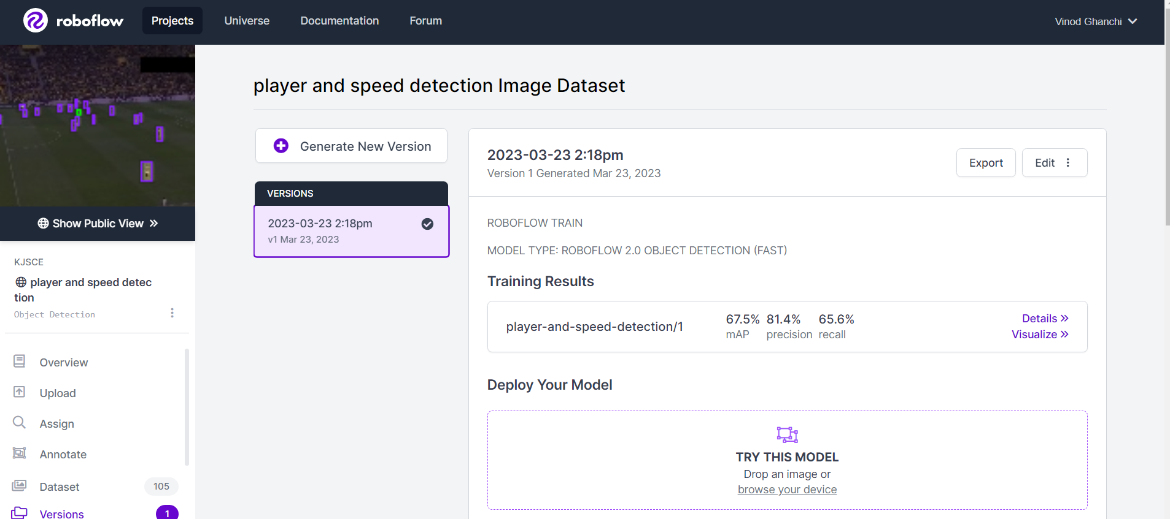
Status (Annotation)

Slide 12
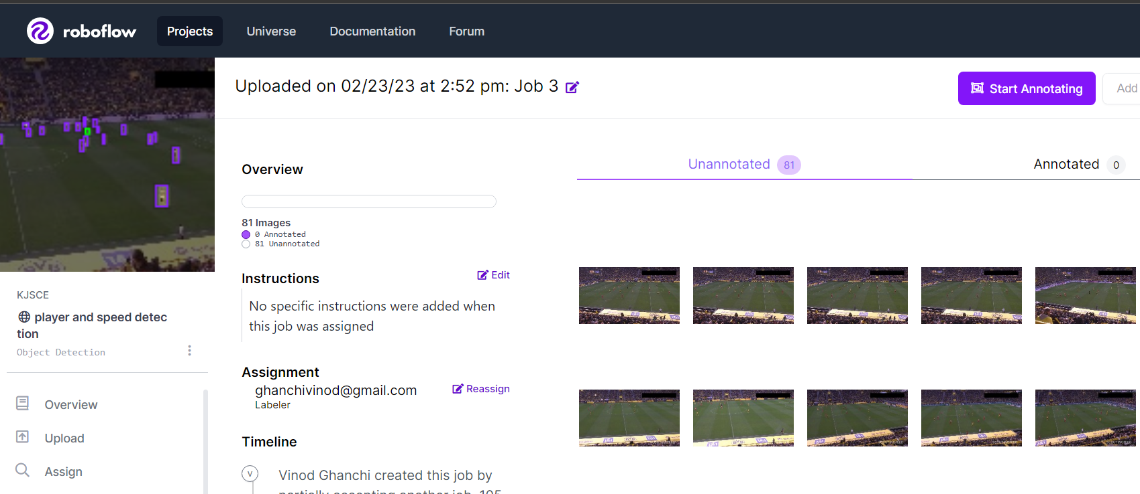
Status (Annotation)

Slide 13
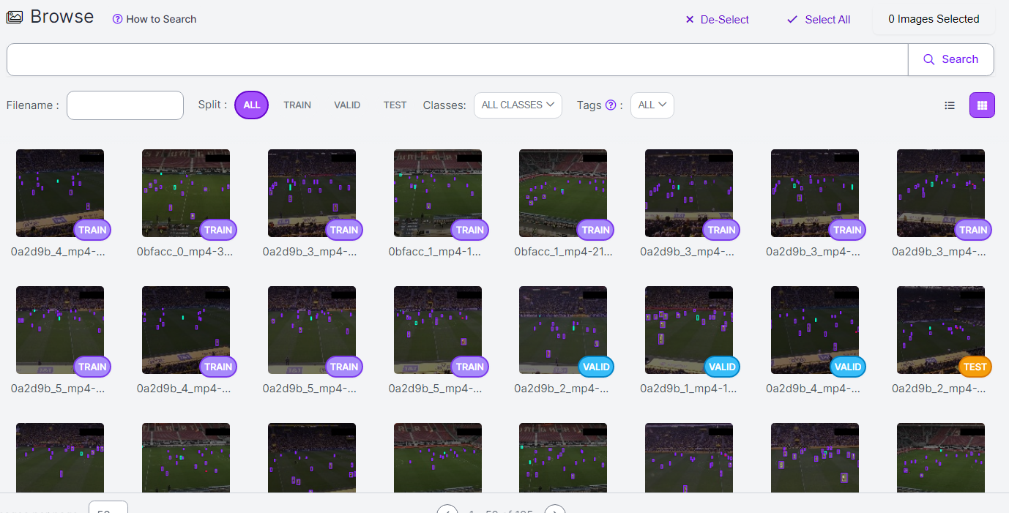
Status (Annotation)

Slide 14
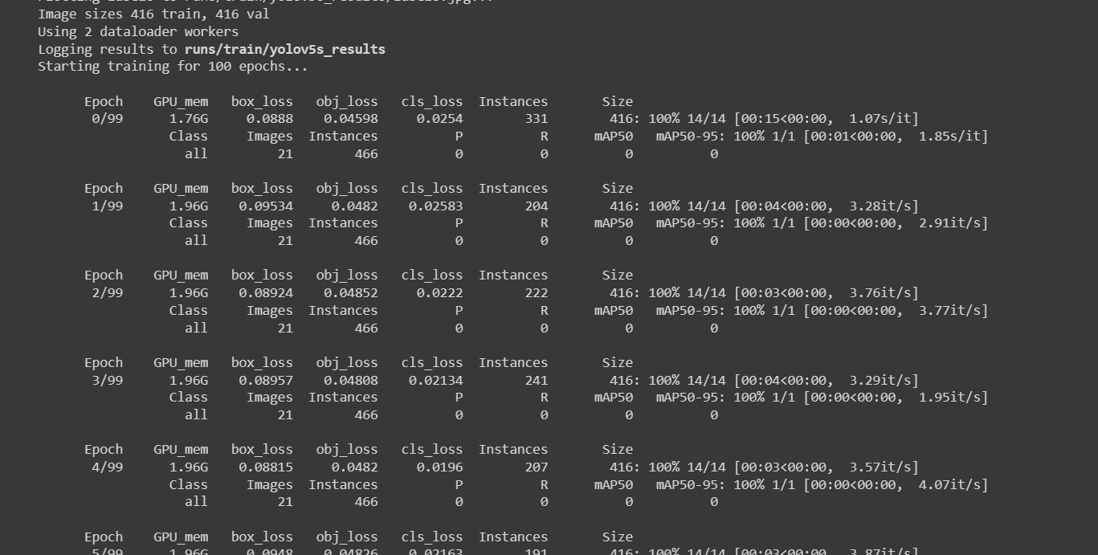
Status (Training Model)

Slide 15
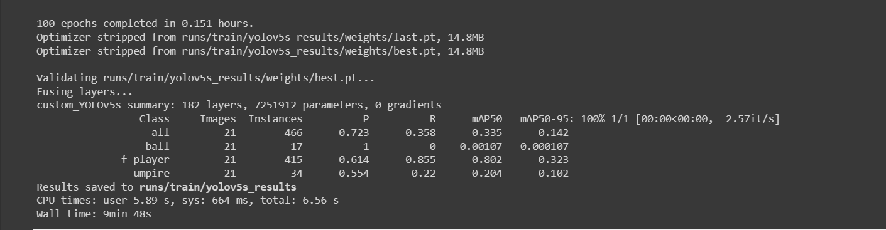
Status (Training Model)

Slide 16
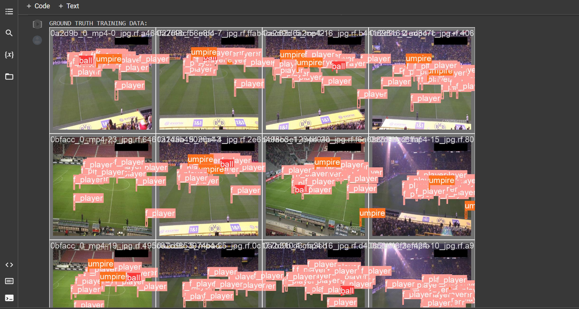
Status (Training Model)

Slide 17
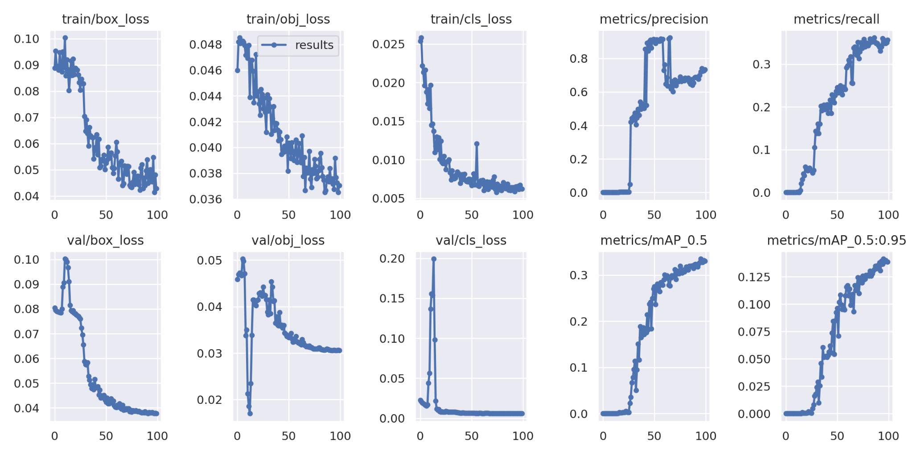
Status (Training Model)

Slide 18
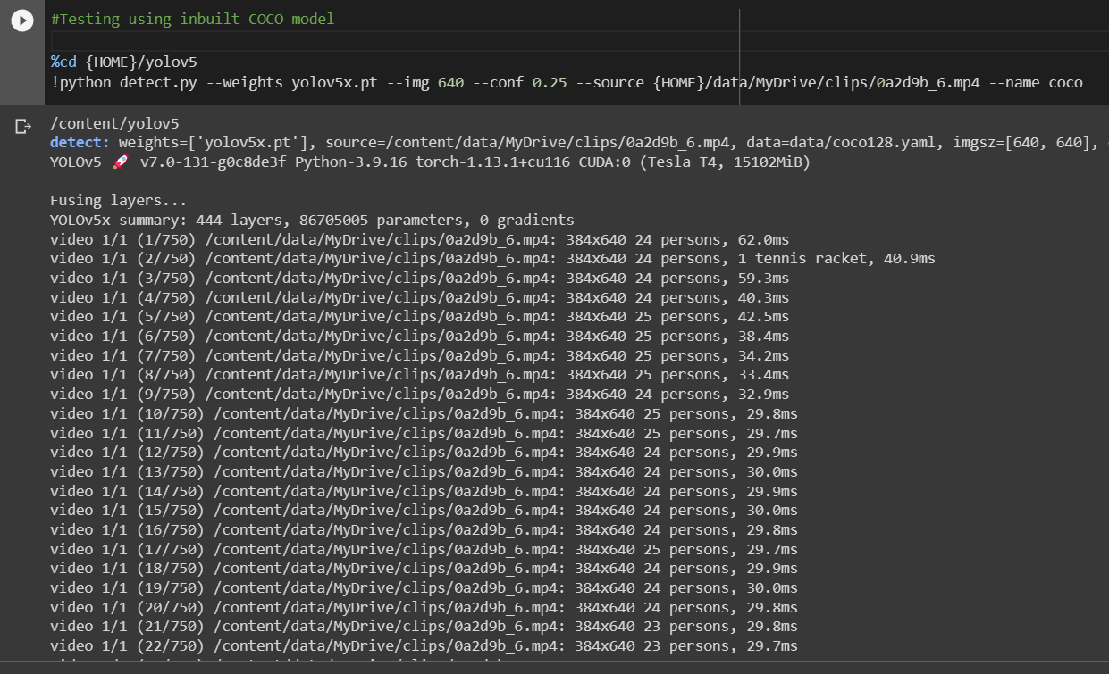
Status (Testing Model)

Slide 19
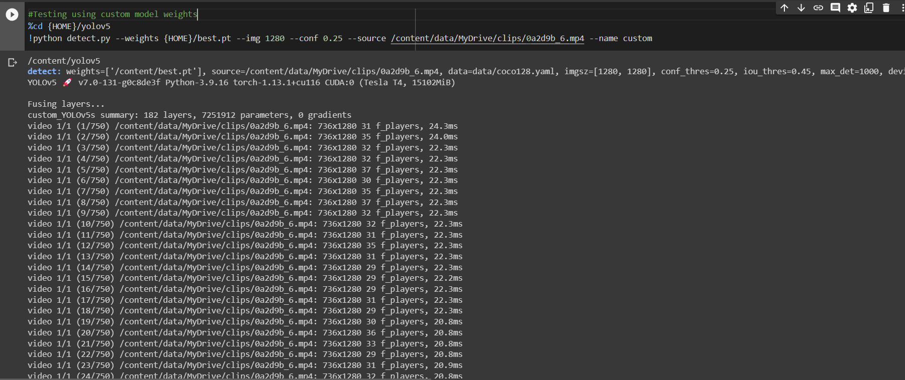
Status (Testing Model)

Slide 20
Status (Training Model)
Ways to improve performance of current model:
Increase the number of epochs in training
Increase the amount of annotated images
Diversify image conditions such as images of varying pitch and weather conditions
Use a newer version of YOLO

Slide 21
Challenges Faced
Some of the various challenges we have faced till now, during the annotating and model building stages are:
Finding a proper dataset, with ample amount of images with proper lighting, camera angle, and definition quality
Creating proper bounding boxes with appropriate margins and padding
Annotating each image one by one takes a lot of time
Difficulty in finding the ball in certain frames
Difficulty in annotating players and/or the referee in separate bounding boxes while they overlap in certain frames

Slide 22
Future Scope
Multiple Player Detection – The system will be able to detect the speed of multiple players simultaneously
Speed Measurement – The system will accurately measure the speed of players in real-time during games and training sessions.
Object Detection – Alongside detecting players, the model should also be able to detect different objects/balls used in different sports.
Movement Tracking – Track player movement and directions across frames

Slide 23
Thank You!

